Slide 1
Wessex Children’s and Young Adults’ Palliative Care Network
Dr Timothy Warlow
Clinical lead and Chair WCYAPCN

Slide 2
Why do we need a network?
‘Evidence consistently shows inequality, with patchy geographical distribution of provision, differing structures, services and models of care among providers and a lack of collaboration and coordination between these organisations.’ Establishing managed clinical networks (MCNs) for children’s palliative care has been proposed to address these issues, and to ensure specialist palliative care is available to those who need it.’
Papworth et al. BMC Palliative Care (2021) 20:20 https://doi.org/10.1186/s12904-021-00712-7
Notes:
This is also true in Dorset and the wider region.
Inequitable – Geography, Time of day, whether child under hospice care or not.
Unsustainable, workforce, right type and skill mix of staff.
Lack of clarity – Need, Geography, organisational roles and responsibilities

Slide 3
What is a managed clinical network?
‘A Managed Clinical Network is a linked group of health professionals and organisations from primary, secondary and tertiary care, working in a coordinated way that is not constrained by existing organisational or professional boundaries to ensure equitable provision of high quality, clinical effective care. The emphasis shifts from buildings and organisations towards services and patients.’
TFSL
Notes:
Key points:
Independent of any of the member organisations making it up.
Structure to facilitate collaboration across primary, secondary, tertiary care, and statutory and non statutory sectors.
Actively seeking to bridge organisational boundaries for those organisations working within it.
Working towards high quality, effective care.

Slide 4
Key principals (NHSE/I)
0-25 years
Equitable care
Sustainable care
Transitional (Perinatal, Transition to adult care)
Primary, secondary and tertiary integration
Follow the patient

Slide 5
NHSE/I National Team
CYP PEoLC Program
Gareth Jones (Lifetime)
Davina Hartley (York Humber)
NHSE/I Regional Team
7 Strategic Clinical Networks (SCNs) (South West, South East)
Charlotte Ives (SW) Natalie Hughes (SE)
Charlotte Mellor (SW) Anna-Karenia Anderson/Emily Harrop (SE)
Local networks
WCYAPCN
Pan Dorset

Slide 6
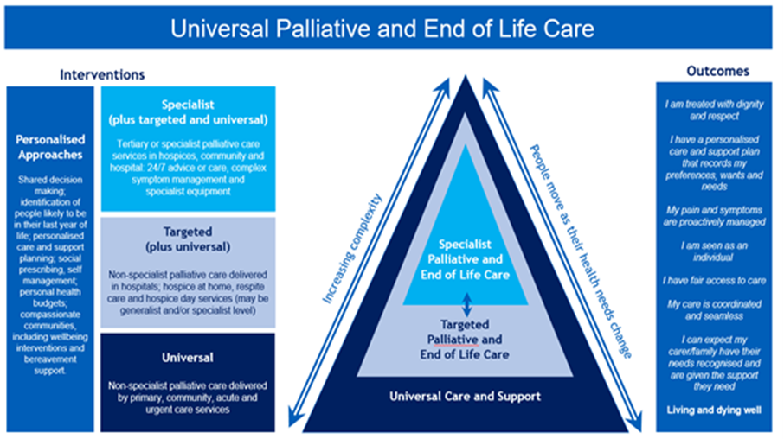
New specification

Slide 7
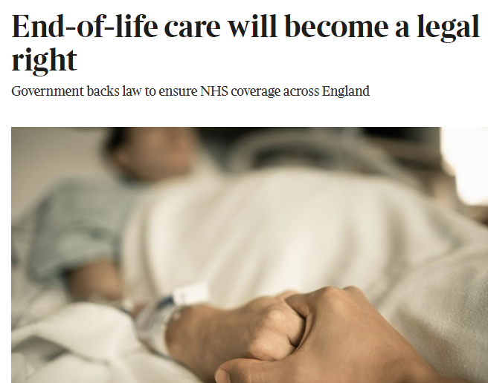

Slide 9
National Goals/Targets
24/7 advice SPPM and palliative care during palliation and end of life.
Equitable access focussing on under-served populations.
Sustainable commissioning
Confident knowledgeable workforce.
Sustainable workforce
Improved patient experience

Slide 10
Where are we in Wessex CYAPCN?
Steering Group
Vision and mission
Service mapping
Stakeholder mapping
Network mapping
Benchmarking NHSE/I outcomes, NICE standards, Ambitions

Slide 11
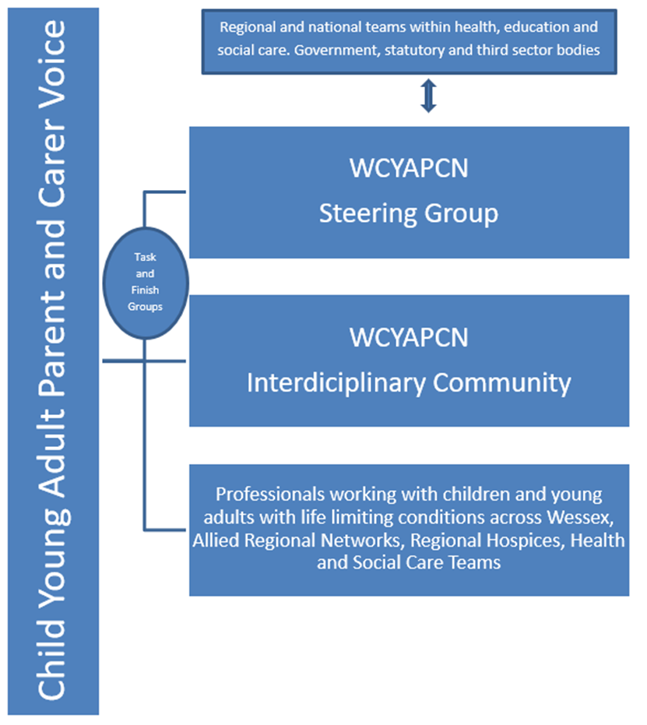
Structure

Slide 12
Vision
To ensure children and young adults with life limiting and life-threatening conditions across Wessex have access to equitable, sustainable, high quality, palliative and end of life care.
Mission
To develop an integrated approach to achieve equitable local and regional palliative and end of life care services for Children and Young Adults across Wessex.

Slide 13
Strategic Aims
Develop a collaborative network co-produced with children and young adults with life-limiting and life-threatening conditions, their parents and carers.
To identify the workforce supporting CYA with life limiting conditions within health, education and social care in Wessex (clinical and non clinical) and provide a forum of support.
Support a strategy for the expansion of workforce in CYA palliative care services across the region, working with integrated care systems to deliver this. Provide education and training in PEoLC to this workforce.
To identify and share best practice from within both clinical and wider professional organisations and networks within the Wessex region.

Slide 14
To develop Wessex wide guidance to support integration across organisational boundaries, ensuring these are operational and applicable across clinical and non-clinical settings.
Advocate for equitable end of life care provision, reducing variation across Wessex, whilst working with integrated care systems to ensure local needs are prioritised.
Advocate for a sustainable, commissioned 24/7 model of end-of-life care including local medical and nursing provision and access to specialist palliative care support.
Align contracting, funding approaches and policy development.
Advocate for CYP and their families to ensure they are represented in the local and regional care planning and commissioning agenda.
Advise on the development of a strategic and integrated approach to local and regional palliative care services across Wessex.

Slide 15
Early objectives
Stakeholder engagement
Steering group established
Other networks engaged (NICU, oncology, Adult Pall Med, Hospice Collaborative, ICB)
Initiating broader forum for all health, social care and education professionals (June 2023).
Governance and approach
Links to HIOW ICB
Steering group and interdisciplinary forum
Strategy development
ICB integration HIOW
CYP specification HIOW
All Ages Strategy HIOW
Supporting other ICS regions – Dorset, Sussex (now self sustaining relationships)
Interdisciplinary network

Slide 16
Benchmarking Methodology
Service Evaluation 2020
Last 15 patients requiring specialist palliative care
Interviews with staff across University hospitals southampton and Naomi House & Jacksplace Hospices
Focus group discussion sector leaders
Creation of bespoke benchmarking table
Ambitions
NICE standards
Risk log

Slide 17
What are we doing well?
Preferred place of care whilst dying achieved in 67% cases.
93% had symptom management plan.
80% had advance care plan
100% of families received some form of psychological support through NHS, hospice or third sector agencies.

Slide 18
Individualised care
Person centred planning
Agreed regional ACP documentation
Named clinical lead
SPPC available across region during working hours.
Agreed shared care approach for NHS providers.
Strong clearly defined leadership for PEoLC
Psychological and bereavement support (oncology and hospice pts)

Slide 19
Clinical risks
Community children’s nursing numbers
Hospice staffing across region (limited respite/stepdown + referrals in from BOB)
Specialist paediatric palliative medicine advice 24/7 (delayed discharge, PICU beds, delayed suboptimal management pain/distress whilst dying out of hours, unsupported nursing teams)

Slide 20
Care across organisations
Rapid transfers
School/community/social care
Hospital discharge for palliative care
ACP storage and dissemination
Transfer to preferred place of care whilst dying
Storage and administration of controlled drugs (policy and practicality)
Data collection, monitoring and reporting. Audit. Evaluation of services

Slide 22
Stakeholder focus group discussion:
1. What are the priorities for your service and sector with respect to PEoLC?
2. What are the key gaps for your service and sector with respect to PEoLC?
Community nursing, specialist nursing, commissioning, hospice management and executive leadership, specialist palliative medicine, adult palliative care and transition and a specialist education provider.
HIOW, Dorset, Sussex

Slide 23
Focus group discussion thematic analysis
Workforce (medical, nursing, carer primarily education support staff and in- school commissioned health staff).
Transition to adulthood
Strategic plan for commissioning PEoLC services for children and young adults.
Education and training was an urgent need across all areas within education, health and social care.
Knowledge gaps: Significant inequalities remain across the region in terms of service offers and service coverage which are not clearly understood at the present time.

Slide 24
Next steps - 2023
Mapping completion (CDOP, transition, service mapping)
Strategy document (All Ages AND CYP)
CYP Specification alongside ICBs (HIOW & Dorset)
Integration new network manager (April 2023)
Integration with ICB data strategy and ACP processes (interoperability)
Integration with All Ages Strategy ICSs (Dorset/HIOW)
Interdisciplinary Forum (June 2023)
Education and training (September 2023 onwards)

Slide 25
Working Groups (mid 2023 onwards)
Workforce
Transition
Benchmarking/data
CYP transformation strategy PEoLC
Hospice collaboration (ongoing)

Slide 26
An interdisciplinary community
Education
Support
Discuss difficult cases
Anything else?
Interdisciplinarity analyses, synthesises and harmonises links between disciplines into a coordinated and coherent whole. Each team member in an interdisciplinary team builds on each other’s expertise to achieve common, shared goals. Team members work together to improve the experience or outcome for the patient by sharing skills, competencies and knowledge across different practices.
Centre for Knowledge & innovation

Slide 27
Now to hear from you
What would you and your team value from an interdisciplinary community?
How often should we meet and for how long? Regular forums or email updates and scheduled courses/events?
Forums - Case discussions, discussion, didactic teaching.
Training – Annual conference? Training days?

Slide 28
Thank you for your ongoing work and support! The WCYAPCN Steering Group

