Slide 1
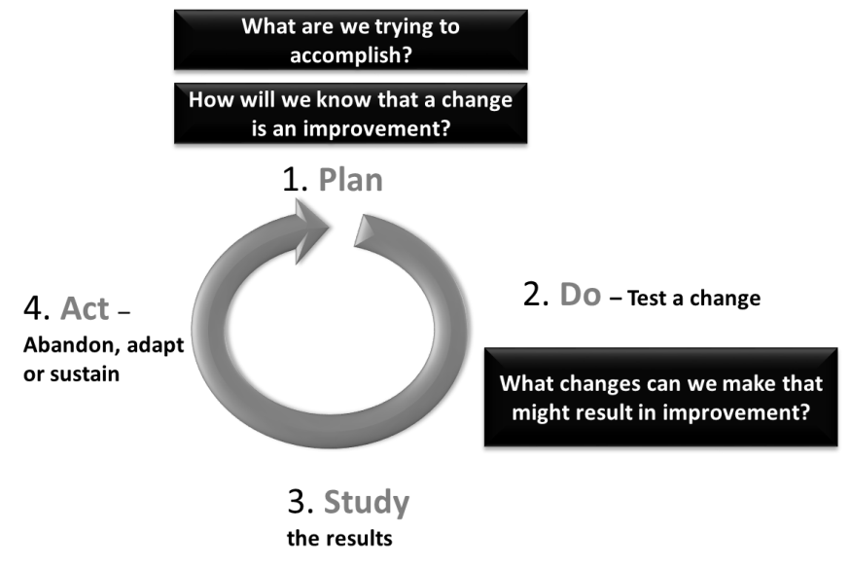
Use this template to help plan your small local change using these steps:
What is the problem & why does it matter?
What are we trying to accomplish?
START HERE
We aim to improve (name the process)
in (location/service)
By working on the process we expect to improve:
(How good? By when?)
The baseline/ current performance is:
It is important to work on this now because:
What data shows this is a real issue? e.g. outcomes, audit, patient feedback
Who needs to be involved?
Decide next course of action / change – repeating the cycle multiple times
Leadership sponsor(s):
Key team members:
Key people to involve:
one page plan
for . . . . . . . . . . . . .
Review the results. What did you learn?
What change will you make?
How will we know if we have made an improvement?
What are the key steps in the process? What are the issues?
The new process / way of working being tested is:
Our final goal agreed with stakeholders is:
The key steps in the process, and main issues are:
Observations of the process in practice:
Potential reasons this issue is happening:
Use the back of this page to map your new process
We will continuously measure how the process is performing by measuring:
The baseline/ current performance (run chart?):
Use the back of this page to map your process
How will you organise this test of change?
We will watch for potential unintended consequences by measuring:
Tasks needed to setup this test are:
We will you collect this data by:

